Slide 1
DEW IT
A Multi-Platform Client/Server Todo-List App

Slide 2
Table of Contents
Design Thoughts
UI Design Examples

Slide 3
Design Thoughts

Slide 4
Design Thoughts
Design for mobile devices (iOS first), and then enrich it for desktop (not the other way around, as I’ve typically done)
Rather than make it just a “TRIVIAL” todo-list app, let’s try to make a Kanban app; a JIRA-replacement!

Slide 5
Design Thoughts (cont’d)
I have no idea how to UI a Gantt chart

Slide 6
Design Thoughts (cont’d)
MVP: Start with the Kanban
The Gantt-charting feature is a nice-to-have for some “Future” version
Bear in mind that the intention is to someday add a useful Gantt-chart UI, so don’t pigeon-hole yourself out of that.
NOTE that this makes coding toward the Gantt feature(s) INTENTIONAL and not SPECULATIVE.

Slide 7
UI Design Examples

Slide 8
UI Design Examples
JIRA
Monday.com
Trello
Other

Slide 9
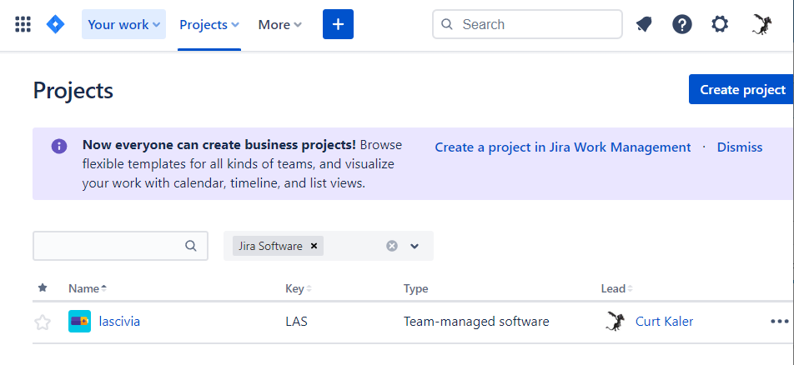
UI Design Examples: JIRA
Another homepage

Slide 10
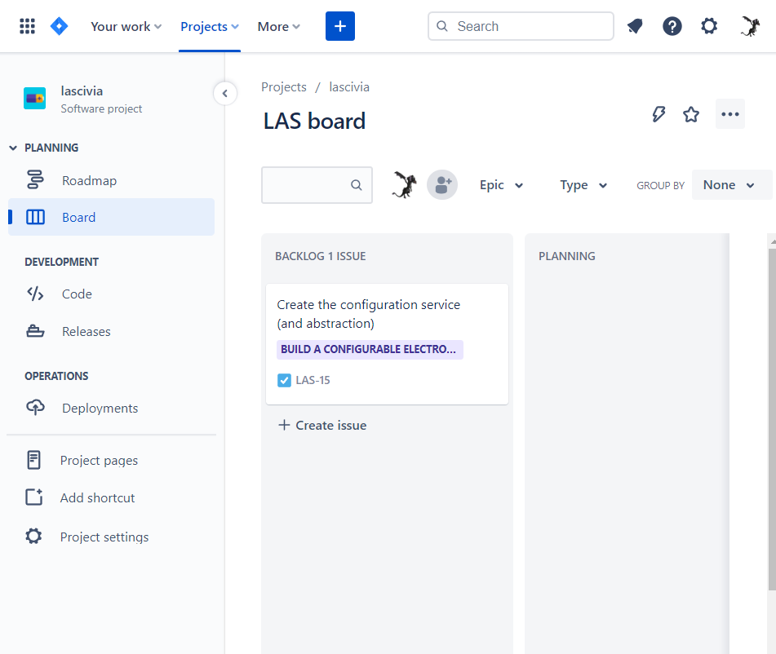
UI Design Examples: JIRA
Project board
Top-header has
Account menu
Settings menu
? Menu
Notification bell
Search
Nav menus
Link to owner’s JIRA homepage
Link to integrated apps
Left pop-out seems pretty unhelpful. Only a few useful options: Roadmap, boards
(roadmap is the Gantt chart, so this could be distilled to a “views” menu)
Filters above the Kanban card view
Maximize/restore button to full-screenify the Kanban itself

Slide 11
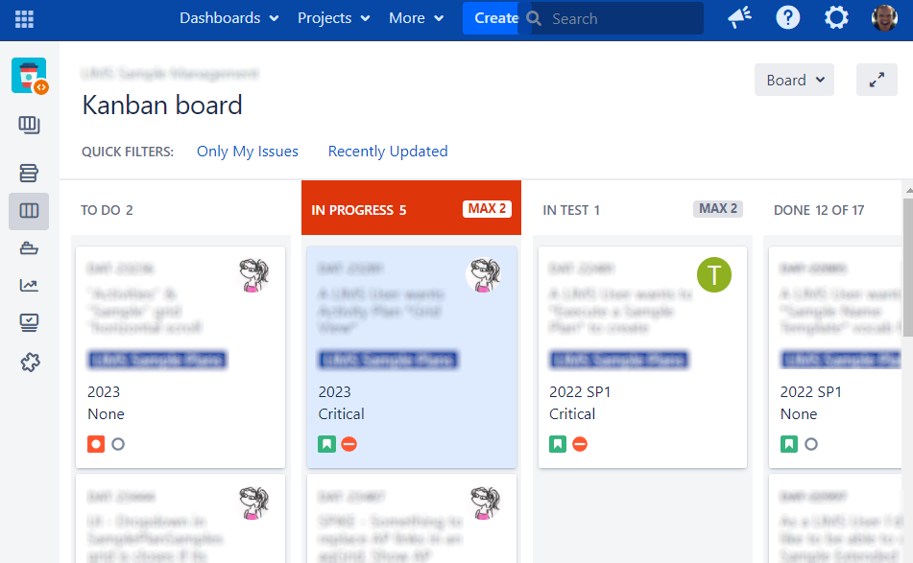
UI Design Examples: JIRA
Maximize/restore button to full-screenify the Kanban itself
Counts in swim-lane headers
“MAX” in swim-lanes, to highlight when we’re overloaded

Slide 12
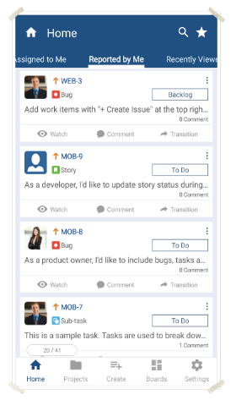
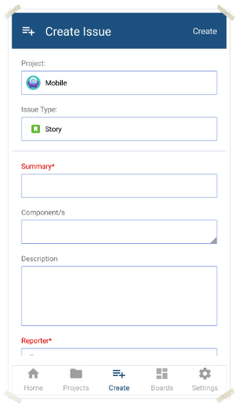
UI Design Examples: JIRA - mobile
Another homepage
“Never miss a beat”
Notifications
Navigation on the bottom
Home, Projects, create, boards, settings
This layout/paradigm looks dated. Can we modernize it?

Slide 13
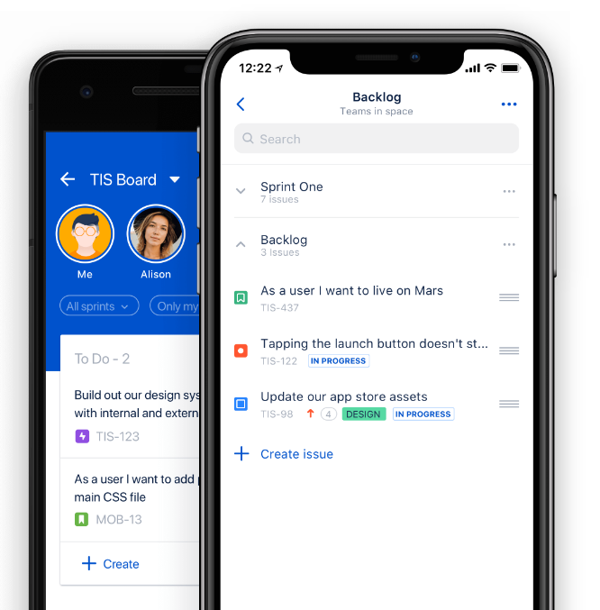
UI Design Examples: JIRA - mobile
“Manage boards and backlogs”
Create, edit, update projects
prioritize
“Create and Edit issues”
Create, edit
Attach
comment

Slide 14
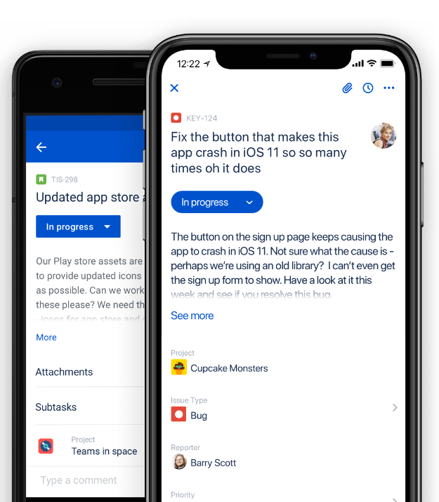
UI Design Examples: JIRA - mobile
“Create and Edit issues”
Create, edit, update
Attach
comment

Slide 15
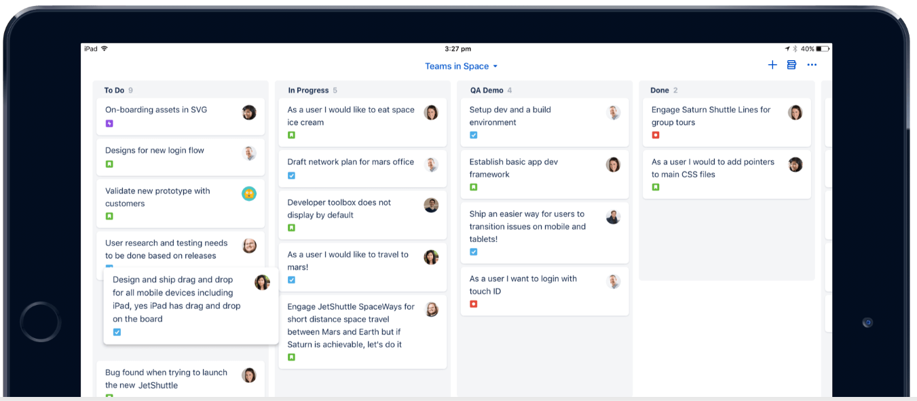
UI Design Examples: JIRA - mobile

Slide 16
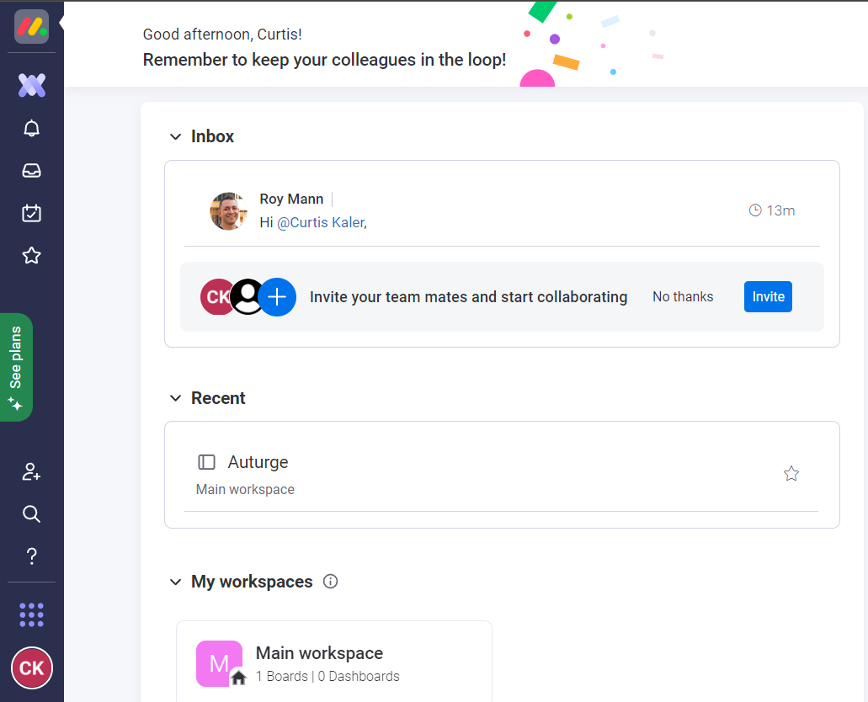
UI Design Examples: Monday.com
Another homepage
Inbox
Recent
My Workspaces
Navbar on left

Slide 17
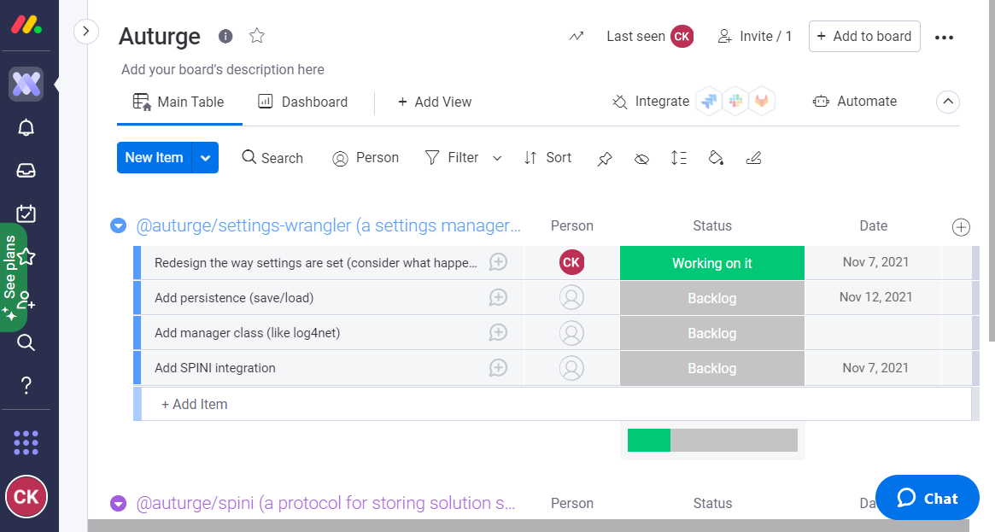
UI Design Examples: Monday.com
Hooks for integrations
That would be an admin-only thing
That means user-levels… we have THOSE at work too. Find a way to not make those painful. Maybe ROLES?
Edit directly in board
Clicking the “Person” shows a popup with a type-ahead
Filter, Sort, pin, hide
Different views appear as Tabs
Nav Bar (top): app, notifications, inbox, calendar (Gantt?), favorites
Nav Bar (bottom): invite, search, account settings

Slide 18
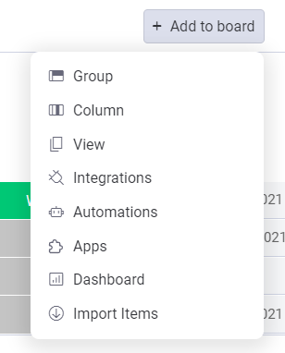
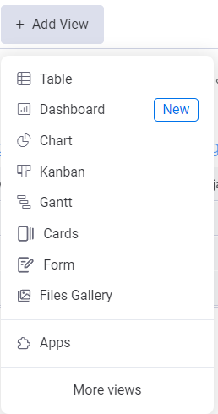
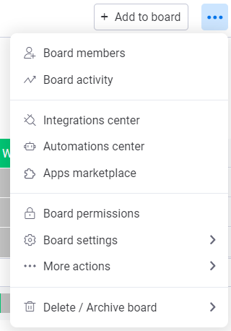
UI Design Examples: Monday.com
Top card is minimizable, expanding screen real-estate for the actual board
Lots of features hidden away in the menus (Invite, add to board, “…”, account settings), leaving the “do work” options right there on the screen
Popout for navigating to different boards

Slide 19
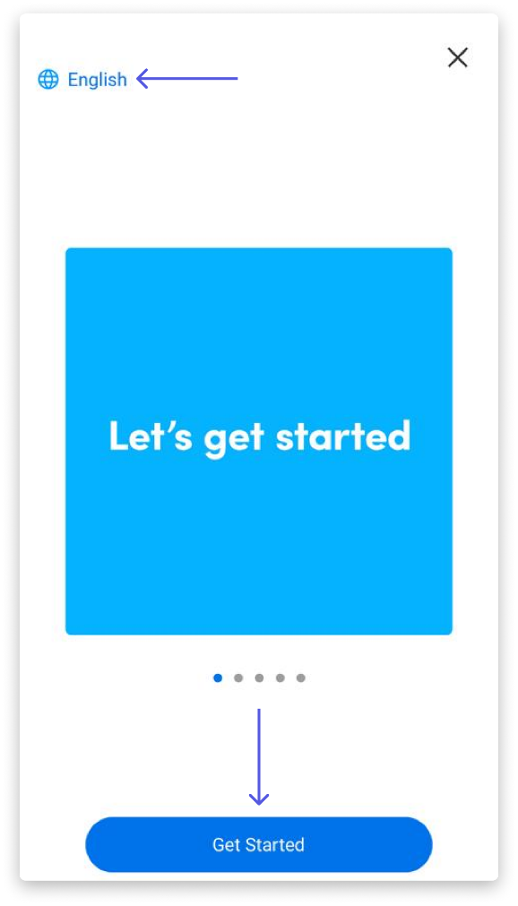
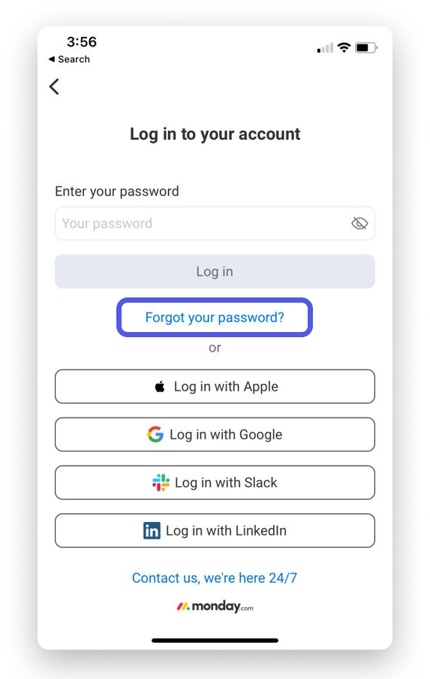
UI Design Examples: Monday.com - mobile
First-time-use wizard to configure app
Next-time login page

Slide 20
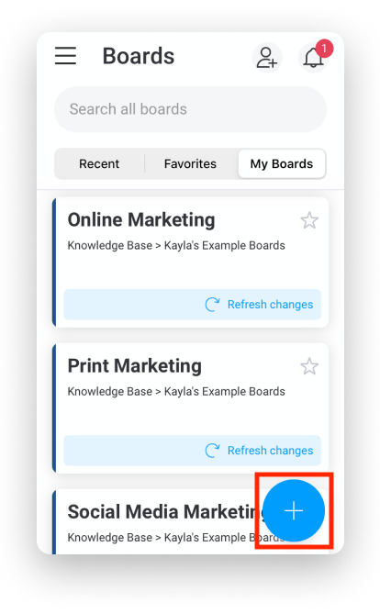
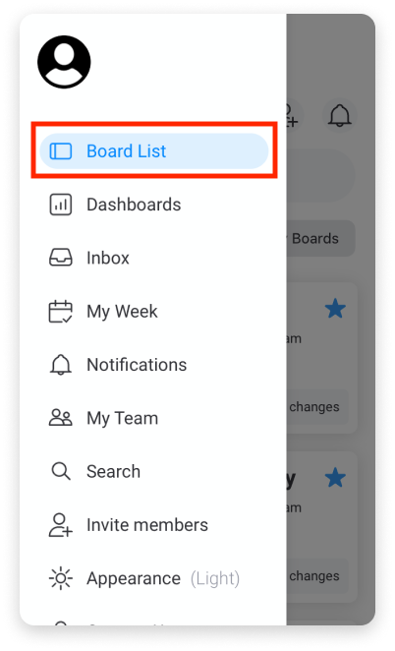
UI Design Examples: Monday.com - mobile
Home page is your board list
Notifications
Search
Create new board
Hamburger menu

Slide 21
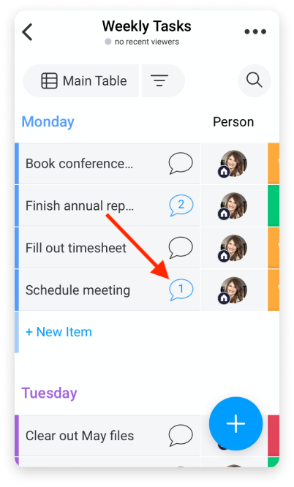
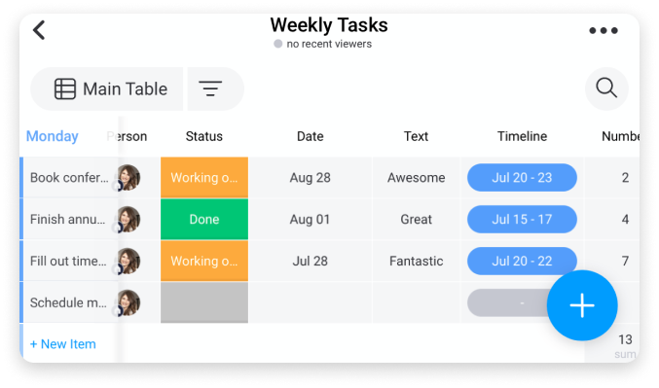
UI Design Examples: Monday.com - mobile
Board items are divided into groups
This one named her groups after days of week

Slide 22
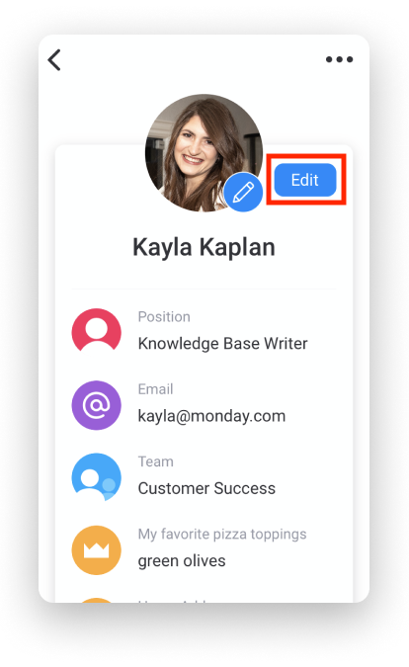
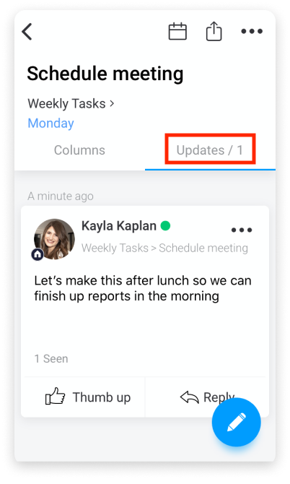
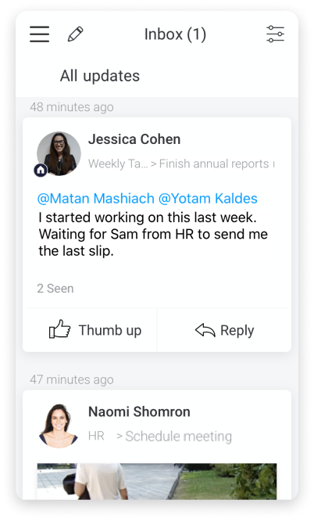
UI Design Examples: Monday.com - mobile

Slide 23
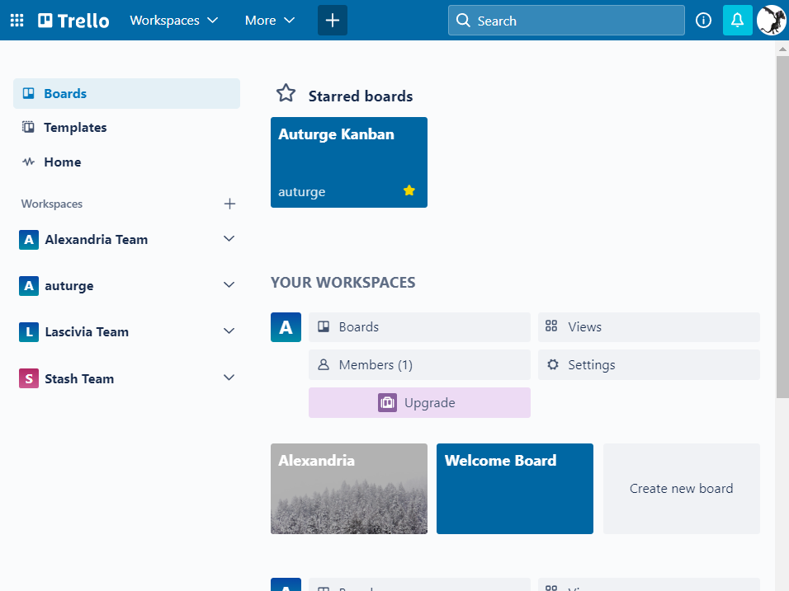
UI Design Examples: Trello
Home page
Multiple Teams
Hey, we have those at work!
Multiple Boards per Team
Hey, that might be handy…
Favorites/stars
Templates
Metadata (boards/views/members/settings)
Settings!
Login
Menubar is not traditional

Slide 24
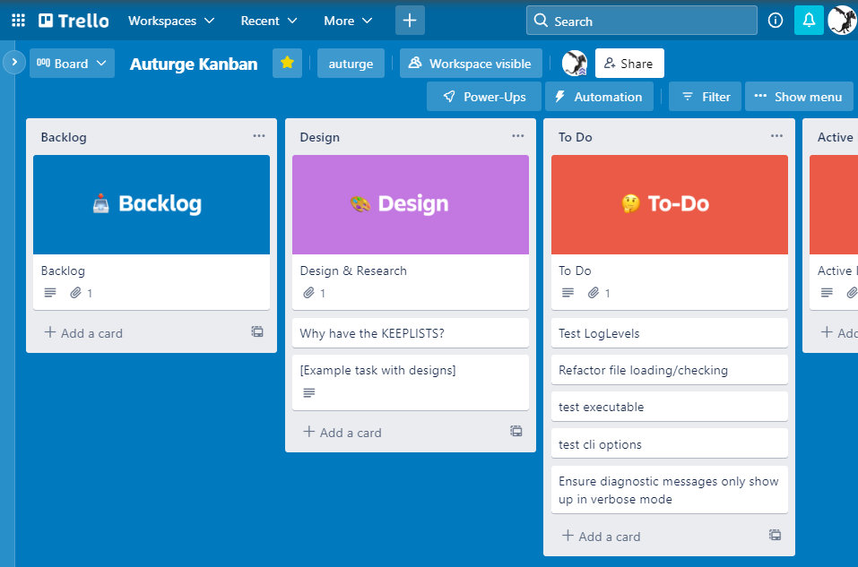
UI Design Examples: Trello
Popouts on left (navigation) and right (“Show menu”)
Hooks for monetization
Hook for SHARING with team members
Simple card-in-card design
Could include a little more metadata? Maybe an option to show/hide metadata?
Assignee / Start date / t-shirt size? / ask others what they’d value
Could use the card-in-card for the basis of the Kanban; i.e., THIS is the MVP
Menu on right: The only extra value I see in this menu is History. Maybe not have a menu just for that
Ugh, HISTORY. That would be an eventual MVP. Put that on the list for sure.

Slide 25
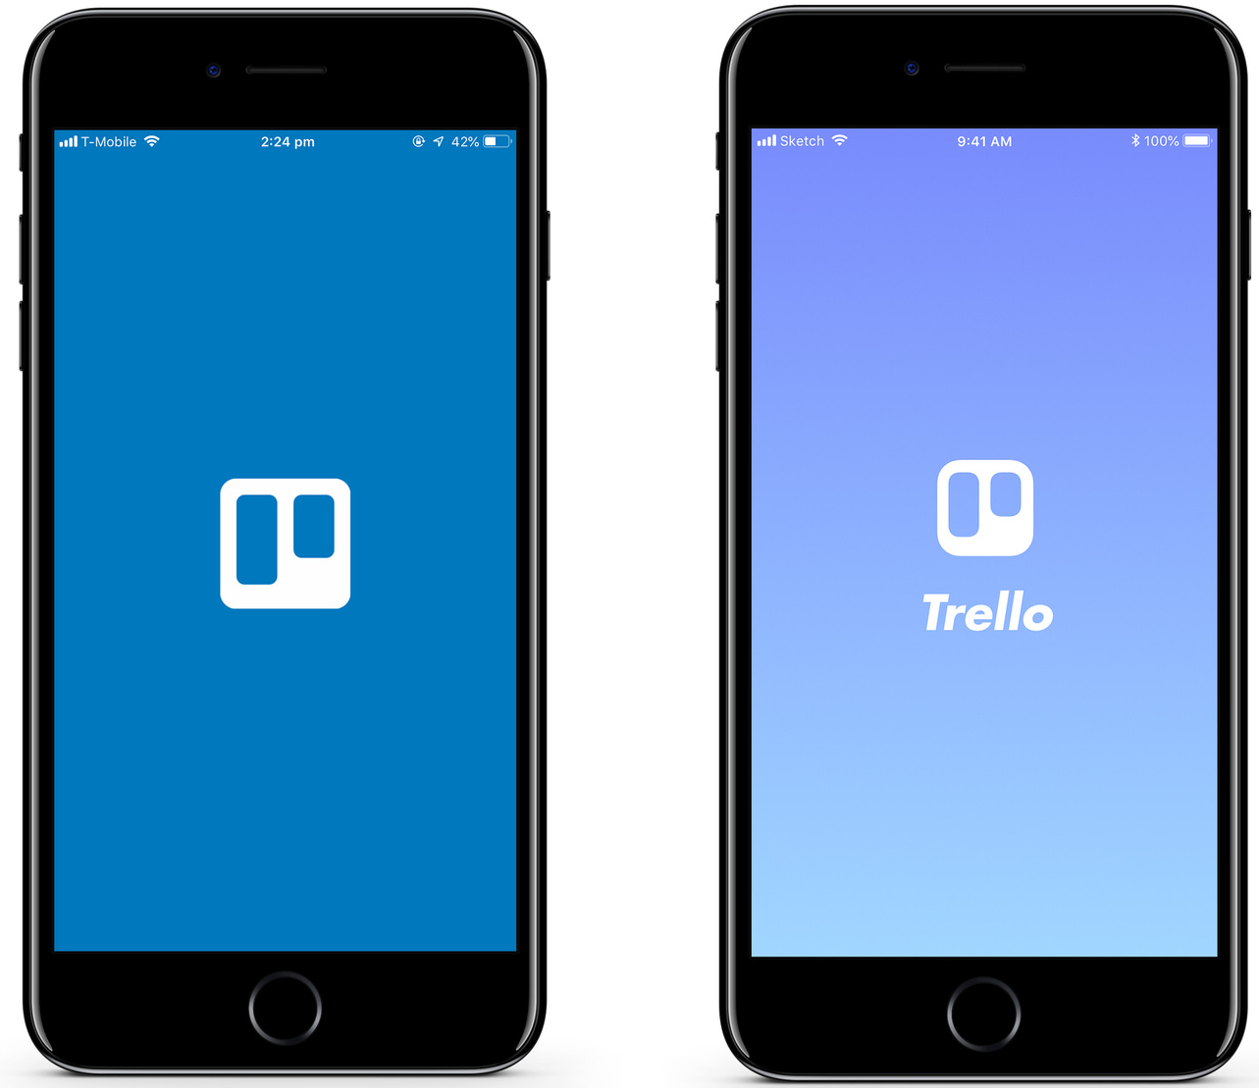
Design Examples: Trello - mobile
Splash page with “redesign” concept

Slide 26
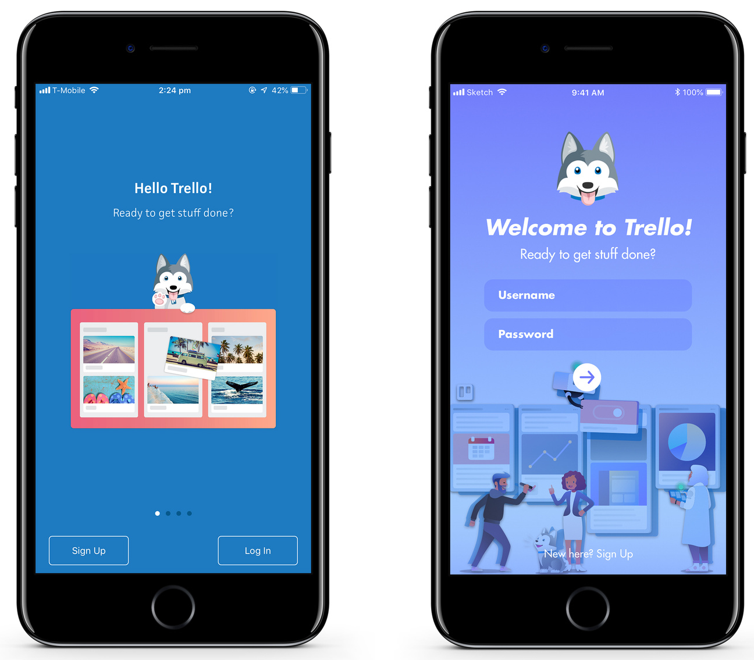
UI Design Examples: Trello - mobile
Login page with “redesign” concept

Slide 27
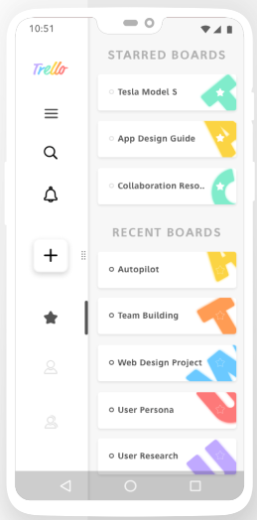
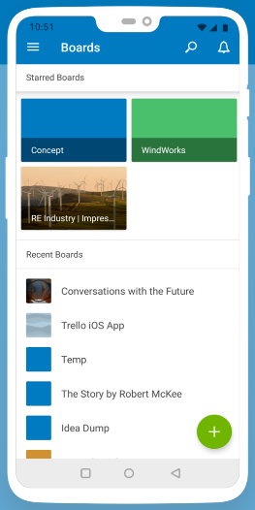
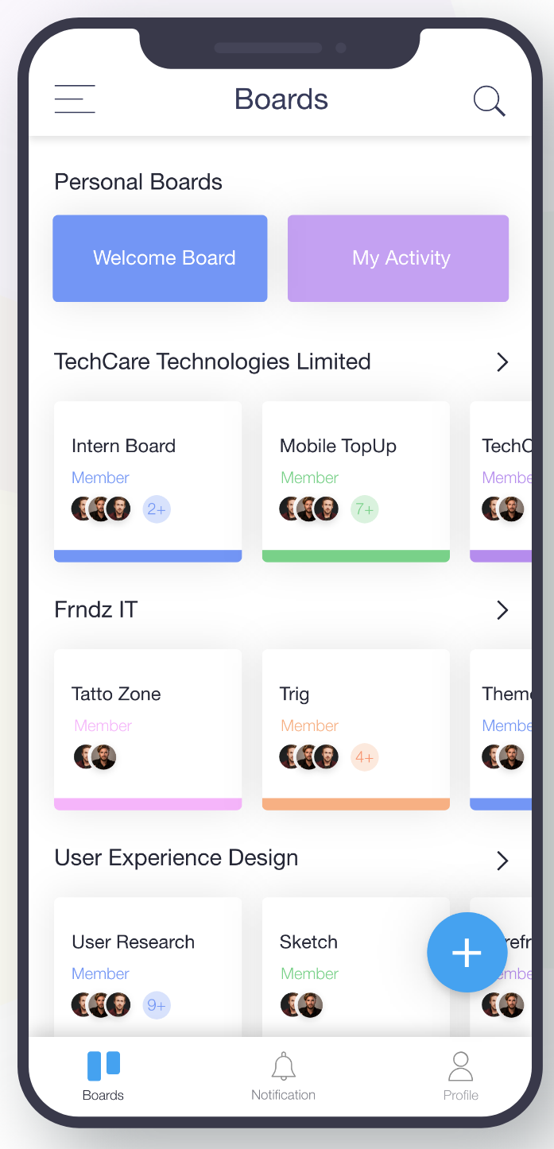
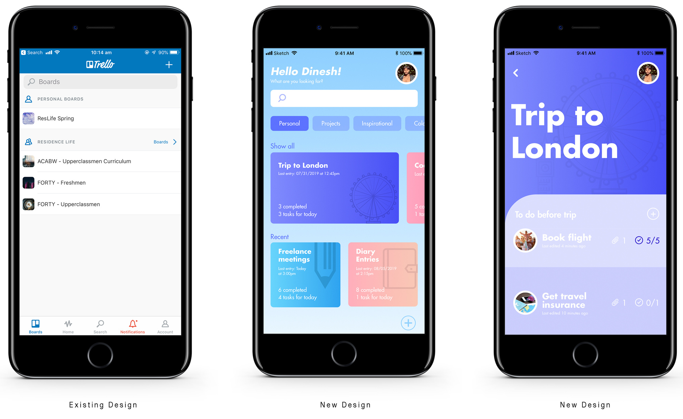
UI Design Examples: Trello - mobile
Boards page with “redesign” concepts

Slide 28
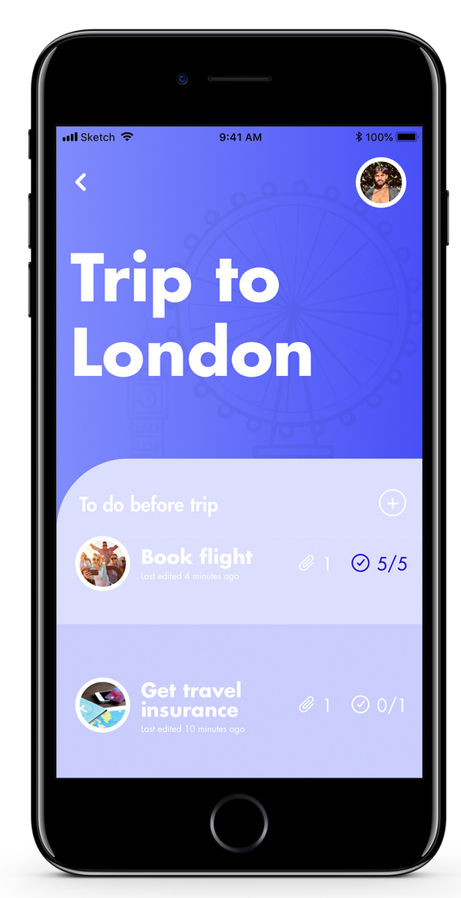
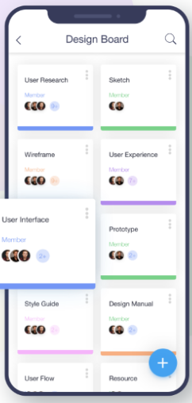
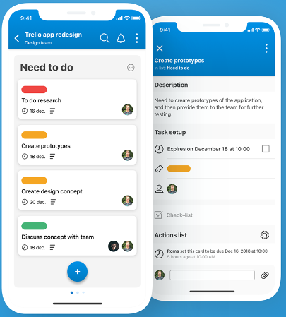
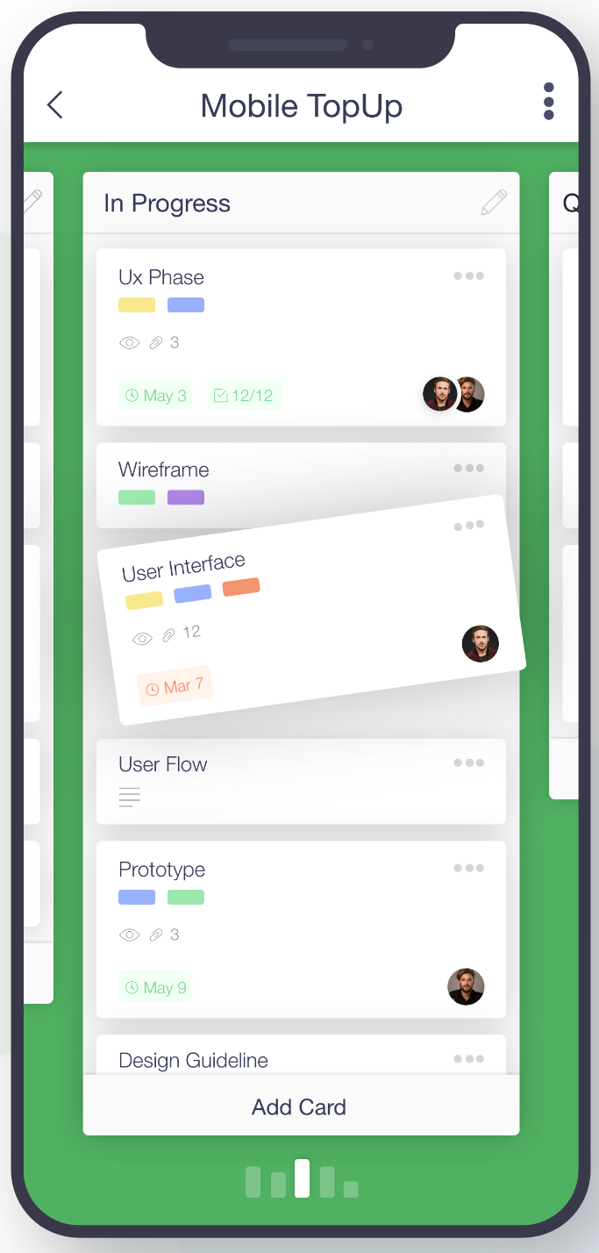
UI Design Examples: Trello - mobile
Board pages

Slide 29
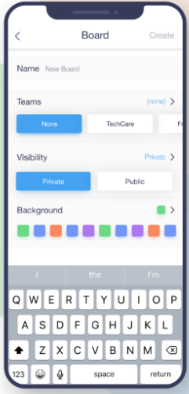
UI Design Examples: Trello - mobile
New Board pages

Slide 30
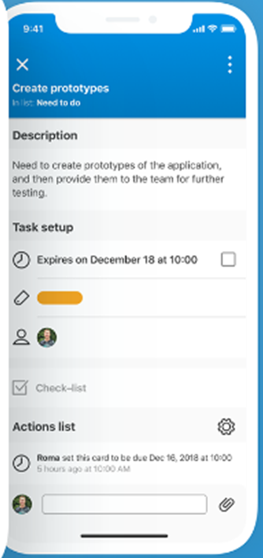
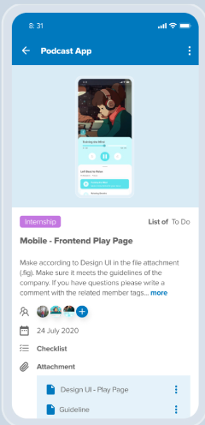
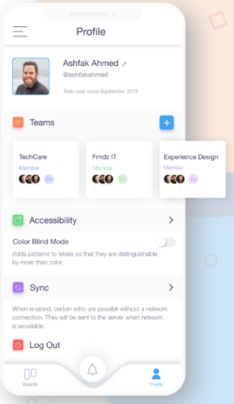
UI Design Examples: Trello - mobile
Item pages
Profile page

Slide 31
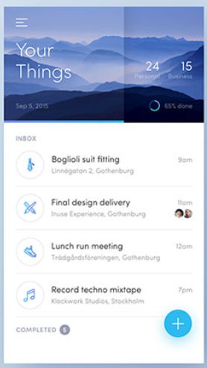
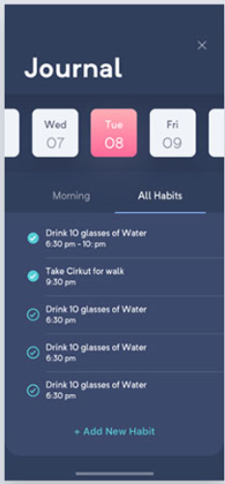
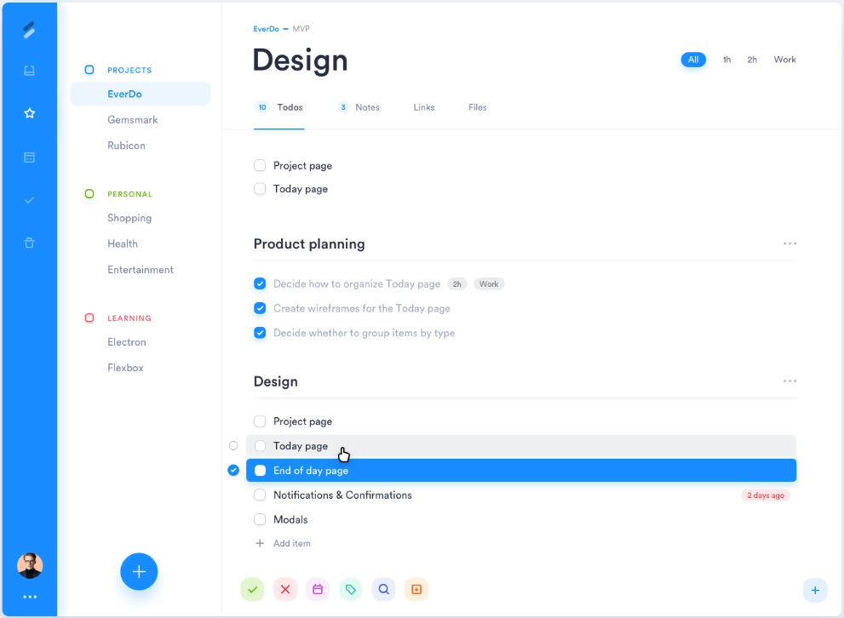
UI Design Examples: Other

Slide 32
UI Design Takeaways

Slide 33
UI Design Takeaways
Typical flow:
Splash page
Setup Wizard page(s)
Login page
Home / Boards page
Board page
Item page
Profile page
Settings page
Other UI Ideas:
https://bashooka.com/inspiration/to-do-list-app-ui-designs/
https://medium.com/product-manager-journal/designing-a-simple-todo-app-b4d4ed9300a4
https://medium.com/user-experience-researche/reimagining-calendar-app-with-cards-c9bb9157db0f
https://github.com/KhaosCoders/wpf-kanban
https://pastebin.com/q0NQUtg4
https://stackoverflow.com/questions/19198834/info-about-to-create-a-kanban-winapp-oriented
Don’t complicate things.
App should be intuitive and guide users in doing the tasks they want to do in the app
App should help the users stay in focus, manage and complete their todos effectively

Slide 34
UI Design Takeaways – cont’d
Themes
Extensible and customizable
Navigation Drawers (pop-outs)
Swipe right to accept, left to reject
HIDE the non-critical path
Cards are Minimalist
Tap the card to dive deeper
How do we tap into this minimalism EVERYWHERE without making the app a CHORE to use?

Slide 35
UI Design Takeaways – cont’d
Splittable nav bar, based on UI orientation
Bottom bar
:Left-bottom when landscape; bottom when portrait
Up to 5 “required” icons MAX (to fit on iPhone):
Notifications bell OR inbox (not both, if possible)
Filter (drawer/popup; content depends on current page)
Home page -> ‘my boards’
Board page ->
My team (“assigned to ppl on my team” filter)
My work (“assigned to me” filter)
My ideas (“created by me” filter)
ellipsis or hamburger nav drawer (nav options? /settings)
Top bar:
Left-top when landscape; top when portrait
Up to 5 icons MAX (to fit on iPhone):
Back nav button
Header text / dropdown
Search icon (right aligned)
Who you’re logged in as (account avatar button)

Slide 36
UI Design Takeaways – cont’d
HOLD UP

Slide 37
UI Design Takeaways – cont’d
Now that we’ve gone down a little bit of the UI rabbit-hole… WHY are we doing Kanban?
Is there a better paradigm?
What do we WANT from DEW IT?
What PROBLEM are we solving?

Slide 38
Problem Statement

Slide 39
Problem Statement
What problem are we solving? And for what role? Vhat value are we after?
That sounds like user-story speak…

Slide 40
Problem Statement – cont’d
As a developer, I need to expand my coding skills, to deepen my understanding of technical concepts and patterns

Slide 41
Bodies of Work

Slide 42
Bodies of Work
A Kanban application with
Multi-platform UI
Landscape (desktop) and portrait (portable) modes
Database persistence
Supports multiple users
Supports multiple customizable boards
Supports multiple customizable groups
Supports multiple customizable cards

Slide 43
Bodies of Work – cont’d
Multi-platform UI
.NET MAUI (C# with XAML, support Mac, PC, iOS, and Android)
Landscape (desktop) and portrait (phone/tablet) modes

Slide 44
Bodies of Work – cont’d
Database persistence
Grails 4, MariaDB
Supports multiple users

Slide 45
Bodies of Work – cont’d
Supports multiple customizable projects
MVP: exactly 2:
“DAT” and “NBK”
MVP: Not customizable (no create, no update, no delete)
Title
Icon
Owner
Maybes:
Sequencing? (DAT-xxxxx)
Permissions?

Slide 46
Bodies of Work – cont’d
Supports multiple customizable boards
MVP: exactly 2 per project:
DAT: “LIMS” and “Capture”
NBK: “Dev” and “QA”
MVP: Not customizable (no create, no update, no delete)
Title
Icon
Owner
Parent
Maybes:
Allowed Users?
Permissions?

Slide 47
Bodies of Work – cont’d
Supports multiple customizable groups/epics
MVP: exactly 2 for each board:
LIMS: “Edit SamplePlan” and “Create from SamplePlan”,
Capture: “Edit Recipe” and “Execute Recipe”
Workbook/DEV: “Technical Debt” and “Hub Integration”,
Workbook/QA: “Regression 202x” and “Automation”
MVP: Not customizable (no create, no update, no delete)
Title
Color
Owner
Parent

Slide 48
Bodies of Work – cont’d
Supports multiple customizable lanes
MVP: “To Do” and “Done”
MVP: Not customizable (no create, no update, no delete)
Title
Color

Slide 49
Bodies of Work – cont’d
Supports multiple customizable cards
MVP: not customizable, cannot choose what goes on the card
Display on mini-view
Card title/topic [text]
Owner [icon]
(Display order) [shown as where it’s placed]
(State/lane) [color brick (when the state/lane is the whole board)]
(Category / Issue type) [small icon]
Priority [small icon]
Comments [icon with badge]
Additional items to display in expanded view
Description
Comments
Category / Issue type
Later:
Genealogy (probably split into several bits)
Timeline (projected start and end dates)
Component?
Label(s)?
Version (discovered, fix)
Resolution?

Slide 50
Bodies of Work – cont’d
Epics | Stories
DataModel | Define the basis of the data model
UI | Generate the basis of a multi-platform UI
 | Enable bootstrapping data, and bootstrap MVP data (all)
 | Create card display UI
 | Group UI
 | lane UI
 | board UI
 | project UI
 | card editor UI
 | Home page UI
 | Settings UI
 | Navigation/shortcuts/junk drawer
 | Filters
 | Notifications
 | Account/User settings
 | Splash screen
Server | Generate the basis of a database-bound, http-enabled server application
 | Enable bootstrapping data, and bootstrap MVP/example data
 | Enable CRUD for cards
Tracked in
GitHub Projects
and
GitHub Issues

Slide 51
Requirements

Slide 52
Requirements
Requirements and work will be tracked as Issues in a GitHub Project

Slide 53
Bodies of Work – cont’d
Epics | Stories
DataModel | Define the basis of the data model
UI | Generate the basis of a multi-platform UI
 | Enable bootstrapping data, and bootstrap MVP data (all)
 | Create card display UI
 | Group UI
 | lane UI
 | board UI
 | project UI
 | card editor UI
 | Home page UI
 | Settings UI
 | Navigation/shortcuts/junk drawer
 | Filters
 | Notifications
 | Account/User settings
 | Splash screen
Server | Generate the basis of a database-bound, http-enabled server application
 | Enable bootstrapping data, and bootstrap MVP/example data
 | Enable CRUD for cards
MVP

